Slide 1
BASIC CONCEPTS
Md. Rokanujjaman
Associate Professor
Dept. of CSE, RU
rokon_cstru@yahoo.com 01712043386

Slide 2
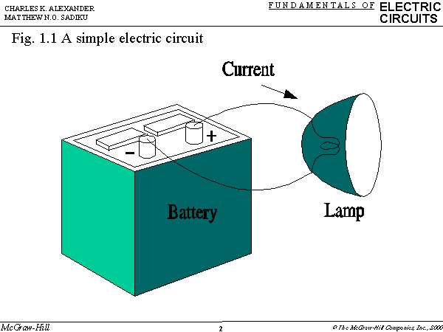
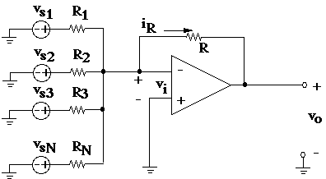
Electric Circuit
An electric circuit is an interconnection of electrical elements.

Slide 3
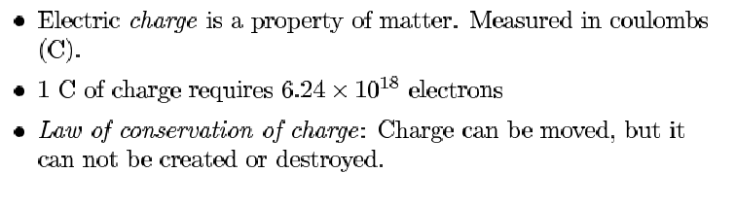
Charge and Current

Slide 4
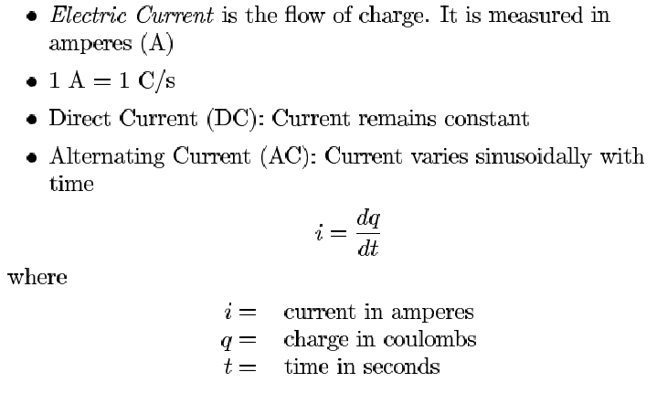
Electric Current

Slide 5
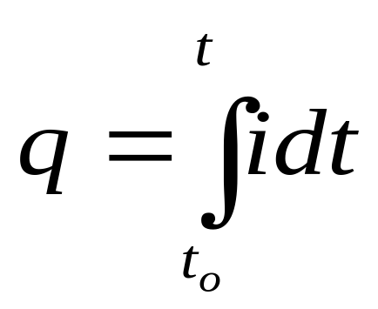
Electric Current
The charge transferred between time t₀ and t

Slide 6
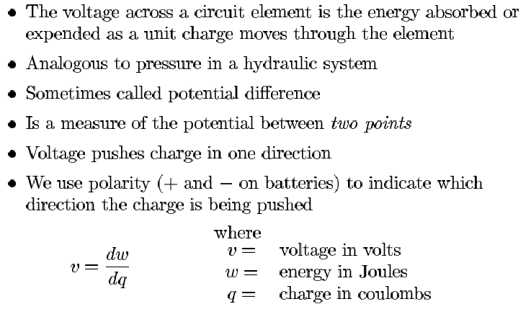
Voltage

Slide 7
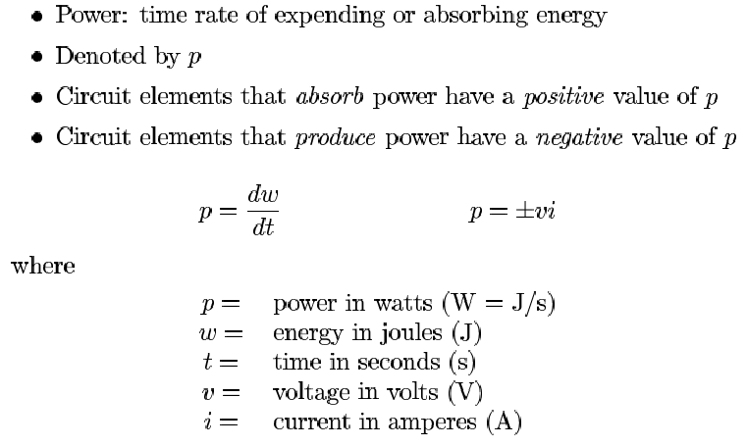
Power

Slide 8
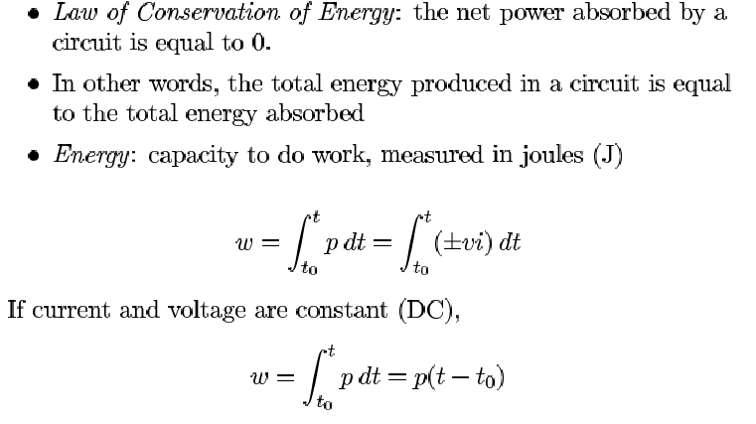
Energy

Slide 9
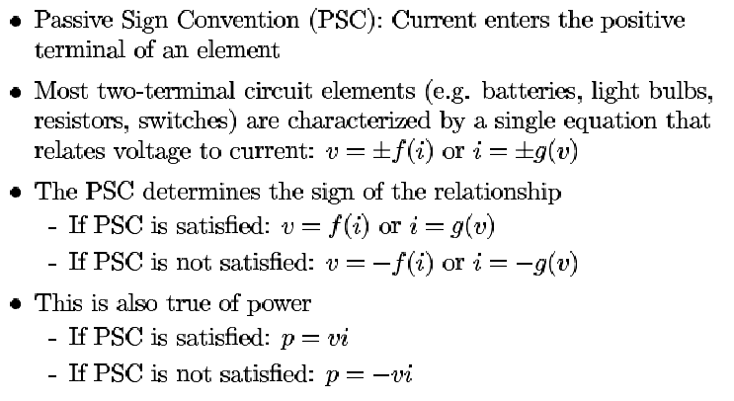
Passive Sign Convention

Slide 10
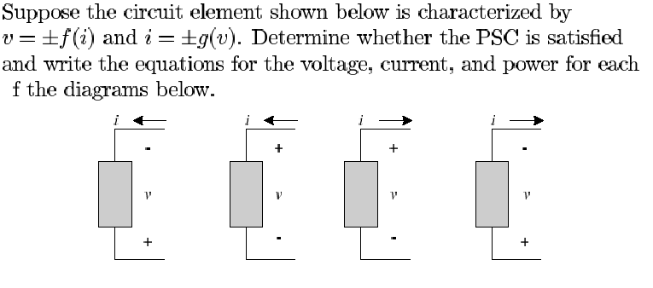
PSC: Example I

Slide 11
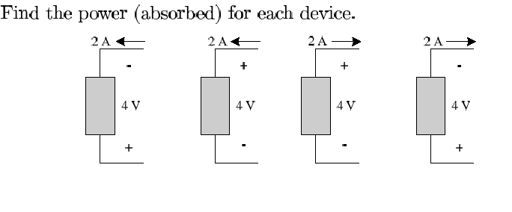
PSC: Example II

Slide 12
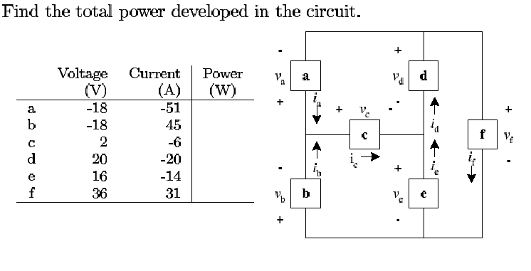
PSC: Example III

Slide 13
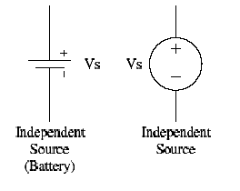
Circuit Elements
Ideal Independent Source: provides a specified voltage or current that is completely independent of other circuit variables
Ideal Independent Voltage Source:

Slide 14
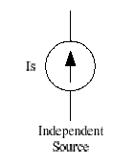
Circuit Elements
Ideal independent current source

Slide 15


Circuit Elements
Ideal dependent voltage source
Ideal dependent current source

